Slide 1
Software Engineering
Chapter 2

Slide 2
So …
Who reviewed last week's material?
When?
The day itself, one day later
A few days later
Just before this lecture
Who made a summary?
Explained things to yourself?
Explained things to fellow students?
Has anyone devised and answered an exercise themselves?
Who looked at the Theory/Lab exercises, …?
These steps are the things you need to learn
The topic ‘SWE’ is a means to learn the essential
HOW TO ‘LEARN TO LEARN’
Notes:
What was important:
REGULAR SLEEP + PHYSICAL EXERCISE
REPEAT, REPEAT, REPEAT, …
STUDY METHOD
https://thomasmore.be/nl/onderwijs-en-leren/leer-studenten-studeren-met-succes
Problems: Over time, over budget, not what was needed
LOC: 20
Coding cost: 1, Analysis & Design: 2, Testing: 3
Most difficult errors in which stage: Design, Programming Logic, Syntax
Total Cost of a SW Project: OTC: 32%, Maintenance: 68%

Slide 3
Software Development
Software development consists of many steps to achieve a good final product
Different categories of / views on SW development
New versus replacement
General purpose versus for 1 customer
Buying or custom-made
AI vs regular SW ^{(*)}
(*) AI-systems is not only AI, also UI, Proj. Mgt, …
Notes:
New SW: replaces work that is currently not done with the help of a computer
Replacement: replaces work that is currently done with the help of a computer

Slide 4
Feasibility
Requirements
UI-definition
Design
SW- Development
System Integration
Verification
Validation
Production
Maintenance
THIS IS IMPORTANT
Project/ Program Management
Documentation
DB Design

Slide 5
SDLC Methodologies
Waterfall
Agile
V-model
Prototype
…
Notes:
V-model: Validation model
Requirements analysis <------------------------------> Acceptance Testing
System Design <-----------------------> System Testing
Architecture Design <-----------------> Integration Testing
Module Design <-----------> Unit Testing
Coding

Slide 6
AI versus traditional SW development
Each step is deterministic — same inputs, same outputs.
Maintenance and Updates happen limited amount of times
AI models are non-deterministic —same input might produce different outputs.
Adapts over time + iterative and ongoing process rather than a one-time build-and-deploy cycle.
Notes:
Issues with AI:
Data contains bias. It is historical data and no human is unbiased.
Data changes over time (data drift: customer profile changes over time)
Concept drift (e.g. a new product category is introduced)
Fairness: Due to black-box approach, the model is not explainable. A major requirement in the industry.
Aspect Traditional AI Development
Primary asset Code Data + Model
Behavior (Requirements) Deterministic Probabilistic
Development style Engineering Experimentation
Testing Exact Statistical performance
Maintenance Bug fixes Monitoring Drift + retraining
Risk focus Reliability, security Bias, drift, explainability

Slide 7
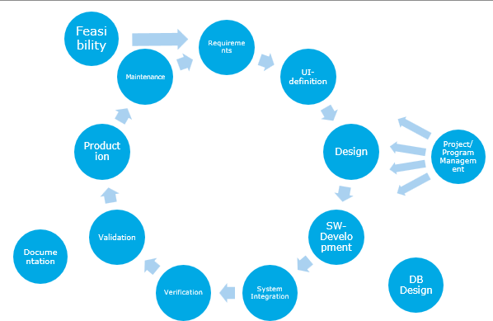
SDLC

Slide 8
Different steps (I)
Feasibility study
Establishing requirements
Design of user interface
Design
Architectural Design
Detailed design
Software development (programming)
System Integration

Slide 9
Different steps (II)
Verification
Unit testing
System testing
Validation/Acceptance testing
Production
Documentation
Maintenance
Project management
DB Design
Notes:
Validation: The end-user accepts the software delivered and acknowledges that the SW is doing what it is supposed to do.
DB-Design is typically NOT part of the SW Engineering

Slide 10
SDLC

Slide 11
1. Feasibility study
Review whether the project is feasible
Why not?
Unnecessary
Too expensive
Too risky
Can be determined via
Technological feasibility
Cost-benefit analysis
Cost > Benefit => DO NOT CONTINUE

Slide 12
2. Establishing Requirements
This is also called the ‘Analysis’ phase
What does the customer want?
Talk to the customer!
Then: Talk to the customer!
And then: Talk to the customer!
Implement what she needs, not what you assume she needs!
Customer knows the business: You are (probably) not a SME.
‘What’ is described. NOT ‘HOW’ a requirement should be implemented
E.g. "What" : Provide a sorted list
"How": Use bubbleSort to provide a sorted the list.
Good analysis, by the analyst, does take into account the implementation possibilities to check technical capabilities.
Results: requirements specification

Slide 13
2. Establishing Requirements
Several steps before requirements are really fixed
Establishing requirements: what, which data in, performance, constraints, what data out
Listing requirements:
Complete, clear
Consistent with other requirements
Technically achievable and testable
Quantifiable: How fast, precise, …
Rank by importance (what’s necessary, what’s nice to have)
Modeling the system
Comparing model and requirements
Following up on requirements
Notes:
Problems
1. Consistent requirements
User 1 wants requirement A.
User 2 want the opposite of that requirement.
Stakeholders should agree which requirements to request
2. Consistent requirements : technically not possibly achievable
Response time of 1 sec, where data is stored on tape.
3. Incomplete requirements
SMEs do not always state explicitly what they are doing
Also weighted against what the cost is for a specific requirement.

Slide 14
Establishing Requirements
WHY: PREVENT SCOPE CREEP
Stable requirements
Good plan
(or better plan)
Achilles heel of Agile
(and the biggest benefit of Agile)

Slide 15
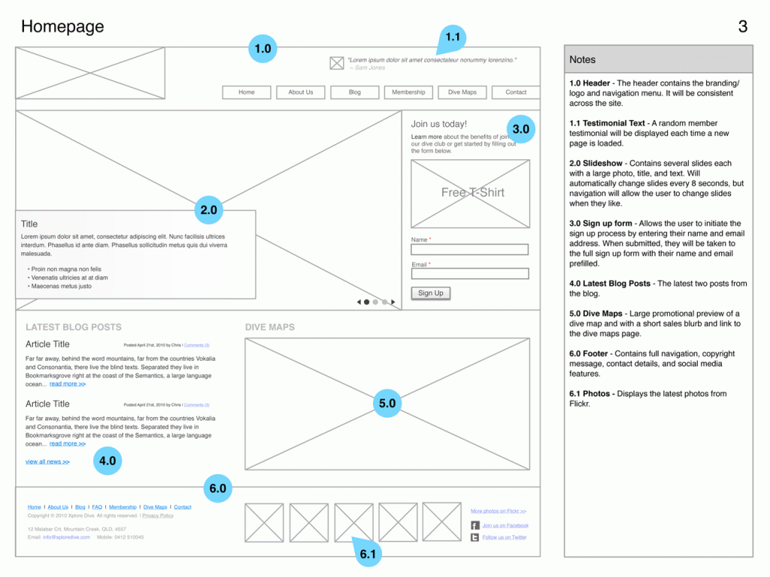
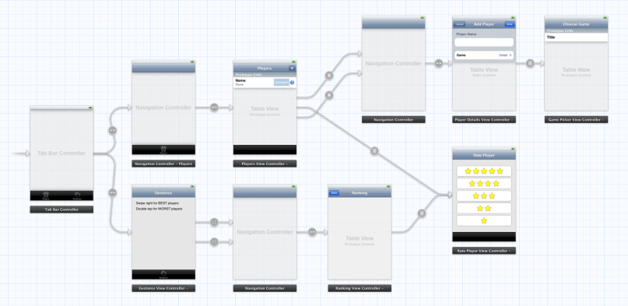
3. Design of User Interface
What will the application look like?
Two steps
Storyboard: user experience
Wireframes: user interface
Notes:
Wireframes / Mockups
Figma

Slide 16
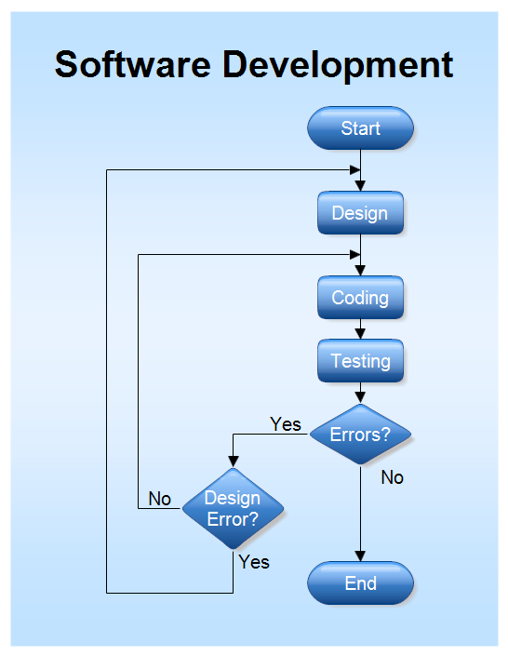
Automated systems
Systems without a user interface
No need for storyboard or wireframes
Make use of flow charts to establish program structure

Slide 17
4. Architectural Design
Breaking down an application into smaller parts or modules
List these modules and the relationships between them
Result: Architectural design and module specification.

Slide 18
4.b. Detailed Design
Each module distilled from previous step is in turn worked out in detail
All relationships between modules are fully described
Result: detailed design of each module

Slide 19
5. Software Development
The actual programming step
The detailed designs are converted into code
Result: a collection of programmed modules

Slide 20
6. System Integration
All modules are molded together into one working whole
Result: A fully working system set up to customer specifications

Slide 21
7. Verification
Testing the application
Happens in several steps
Unit Tests: Testing of all modules separate
Integration test: Testing the flow between linked modules
System Test: Testing the entire application
Result: Reports with test results of all types of tests

Slide 22
8. Validation
Provide the application to end user(s)
Does the application meet the specifications drawn up in advance?
Does the application meet user expectations?
What the user requests and expects is not always the same
Some functionality can always be improved
Acceptance test: let the customer test the entire system
Result: The product is approved or a list of errors and improvements is compiled

Slide 23
9. Production
After the system has been fully tested and made as bug-free as possible, it is integrated into the production environment
This often precedes training for users

Slide 24
10. Documentation (I)
An important aspect for all stakeholders of an application
Users need information about how the application works
Installation
De-installation
User Guide

Slide 25
10. Documentation (II)
Developers need to build the application
Specifications
What modules exist
How are these linked to each other
Documented code
What tests exist and what are the results

Slide 26
11. Maintenance
Updates
Bug fixes
Solving stability problems
Performance improvements
Upgrades
Enhanced functionality
New functionality

Slide 27
12. Project Management
One of the most important parts
Preparation and adjustment of schedule
Troubleshooting
Allocating people
Follow up on project progress

Slide 28
SDLC
Some FINAL Remarks

Slide 29
No sequential plan
The different steps do not necessarily take place one after the other
Often parallel tasks
User interface and architectural design
Implementation of modules and testing of other modules
Some tasks recur regularly
Verification and validation
Project management throughout the entire project

Slide 30
Process model
Software engineering consists of different types of step plans or process models
Waterfall
Prototyping
Incremental
Agile
Spiral
Open Source
Ad Hoc

Slide 31
Hacker = Anti software engineer
A programmer without a plan, who develops a well-functioning application with superior skills
Used primarily for personal projects
Open Source software suffers from this as well
The hacker does earn his spurs in the community with this, but will never develop enterprise software that way

Slide 32
SDLC
Feasibility

Slide 33
ChatGPT – help me with Feasibility
For a new software project, where the new software needs to replace older software, what elements should be included in a business plan to deliver the project properly?

Slide 34
Example: PBX/POTS to Teams (naIve)
Old telephone system needs to be replaced with Teams service.
Notes:
POTS: Plain Old Telephone System
Setting: Existing large company in the 2010 timeframe that wants to migrate from a PBX (Private Branch Exchange) to Teams environment.

Slide 35
Example: POTS to Teams (realistic)
More realistic, but look out:
One Time Costs (OTC)/Charges
Recurring every month/year
multi-year evaluation
Buying Servers = OTC
Maintenance cost = every month/year
Look out, long term
some investment (=OTC) costs become recurring
Servers will have to be replaced after 3-5 years
Financial depreciation will impose re-investment

Slide 36
Feasibility study

Slide 37
Feasibility study
Answer the question
Is it worth starting the project?
From a technological point of view
From an economic point of view
Possible other point of view

Slide 38
Technological Aspect
Can the customer's request be converted into a working application?
Are the requirements realistic
Is the knowledge available
Is the time frame sufficiently large
Is the technology to start the project in place?
Is the existing hardware powerful enough

Slide 39
Economic Aspect
Cost-benefit analysis
Cost Savings of the system
(Add’l) Revenu creation
Profit the system can generate
If multiple solutions are possible, all must be compared
Maintaining the current system
Buying an existing system
Updating the system
Buy and customize a from the shelf solution
Implementing a different approach to the problem
…

Slide 40
Cost of a system
Purchase of hardware
Software development/purchase license
Training end-users
Loss of revenue during commissioning
Maintenance of the entire system
Repair/Maintenance costs of hardware
New HD-agents?
Turnover loss during outage and repair
Upgrade of hardware
Education
…
Notes:
Again:
Software development is only part of the TOTAL cost.
And we already know that developing software is NOT only looking at the cost of “writing software” or “developing software”. There are many stages in the SDLC

Slide 41
Profit OF a system
New Revenue – Additional Cost = New Profit
Take into account
Automation => Productivity increase (more time to do other stuff)
Maintenance => Cost increase

Slide 42
Example
business case feasibility.xlsx
Business-case-enhancements.md
Business-case-feasibility-Teams_PBX_5Y_Model-Final.xlsx

Slide 43
Other criteria
Not everything can be reduced to a cost-benefit analysis
Some people like to create software
Military projects deemed necessary
Projects that are socially acceptable
Website for looking up train hours and routes
People able to check in, review medical records and schedule appointments online

Slide 44
Sometimes FEASIBILITY IS simply ignored
An idea is suggested
People get behind it and idea gains momentum
There is talk of a business case for the system
Positive aspects are highlighted
Negative is barely looked at and discussed

